Slide 1

Fundamentals of Mathematics for Machine Learning
Oxford ML Summer School
8 May 2023
Rasul Tutunov
Juliusz Ziomek

Slide 2

Plan of the Talk
Linear algebra
Vector Calculus
Probability Theory
Loss functions in ML
Courtesy of Robin Halwas

Slide 3
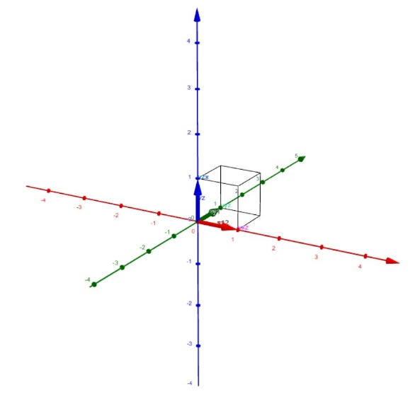
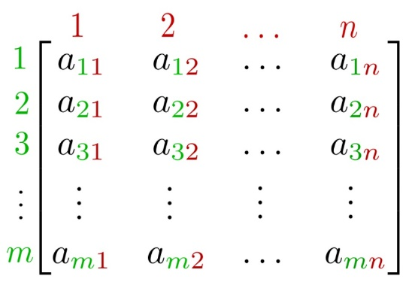
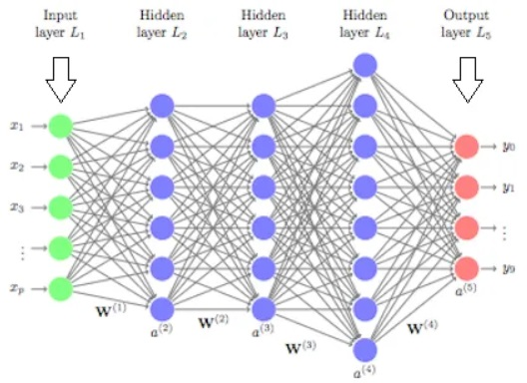
Linear Algebra
Vectors in Euclidian Spaces.
Definition, properties, and examples.
Length, inner products, norms, metrics.
Linear Independence.
Matrices
Definition, properties, and examples.
Trace, inner products, norms, metrics.
Symmetric matrices, positive semidefinite matrices.
Eigenvalues, eigenvalue decomposition.
Cholesky Decomposition.
Courtesy of Vishal Yadav

Slide 4
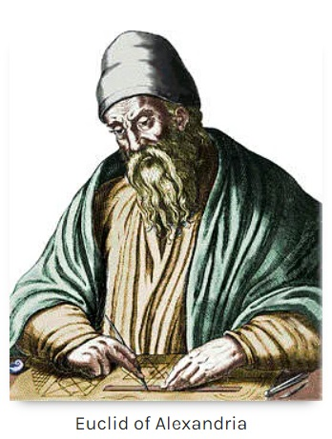
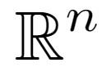
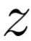
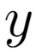
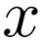
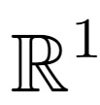
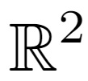
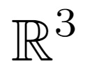
Euclidian Space
Euclidian Space:
A space in any finite number of dimensions n, in which points are
designated by coordinates (one for each dimension) and the distance
between two points is given by a distance formula.
Typical notation:
Coordinates of Points
An ordered collection of n numbers, identifying the location of points in space
with respect to predefined reference lines (called coordinate axes)
Examples:
2
2
1
A
A
-1
1
2
3
A
1
1
0
-1
0
1
2
2
-1
0
1
2
A = 0.5
A = (1.5, 1)
A = (2.5, 2, 1.5)

Slide 5
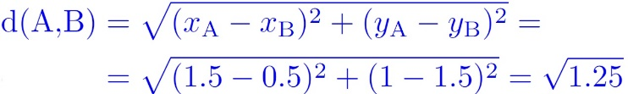
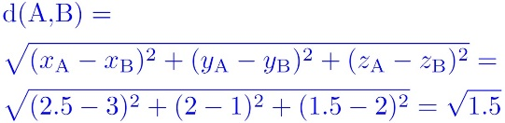
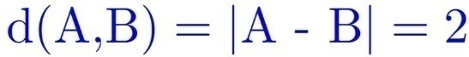
Euclidian Space
Euclidian Space:
A space in any finite number of dimensions n, in which points are
designated by coordinates (one for each dimension) and the distance
between two points is given by a distance formula.
Typical notation:
Distance Formula
Algebraic expression that gives the distances between pairs of points in terms of
their coordinates
Examples:
A = 0.5
B = 2.5
A = (1.5, 1)
B = (0.5, 1.5)
A = (2.5, 2, 1.5)
B = (3, 1, 2)
0
A
1
2
B
-1
B
2
B
2
A
1
1
A
-1
1
2
3
-1
0
1
2
1
0
2

Slide 6

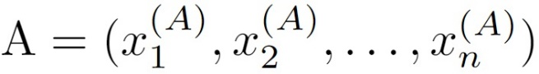
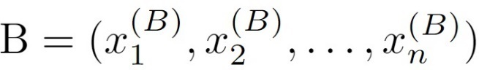
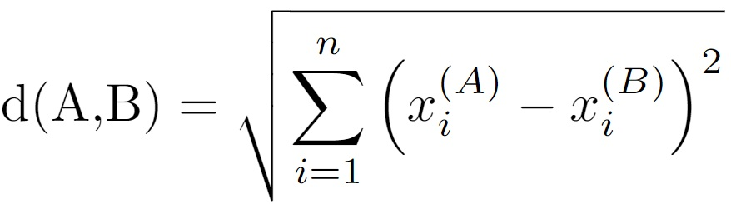
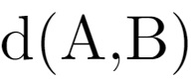
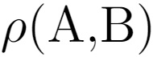
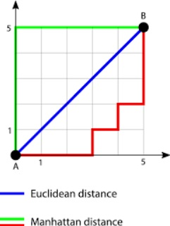
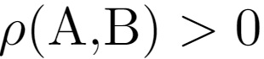
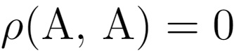
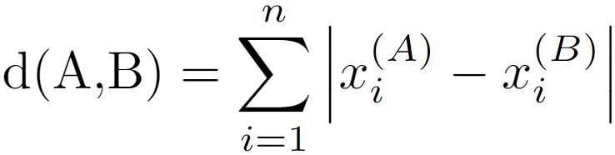
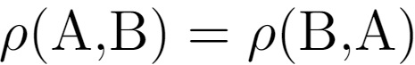
Euclidian Spaces
In n-dimensional Euclidian space , each point is designated by n coordinates:
Distance (Euclidian) between two points and is defined as:
Remark:
Distance function in Euclidian space, can be defined in many ways. Actually any function n satisfying the
following metric axioms is a valid distance:
Example:
For any distinct points A and B it is positive:
For any point A:
Manhattan distance:
For any points A and B it is symmetric:
For any points A, B and C we have triangular inequality:

Slide 7
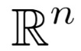
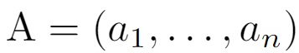
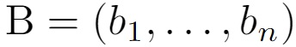
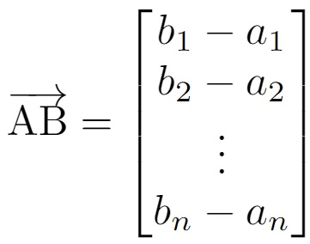
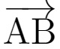
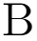
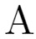
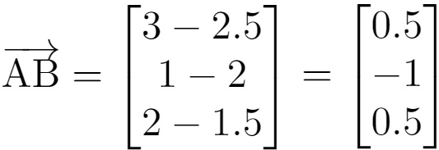
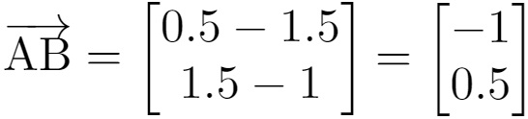
Vectors in Euclidian Spaces
Vector in Euclidian space is a geometric object that has magnitude and direction. It characterized by two points:
the beginning point and the end point .
components/coordinates of
Magnitude of vector is its length. Typically, is defined via distance measure between points and .
Examples:
A = (2.5, 2, 1.5)
B = (3, 1, 2)
A = (1.5, 1)
B = (0.5, 1.5)
B
2
2
B
1
A
A
-1
1
2
3
1
0
1
2
-1
0
1
2

Slide 8
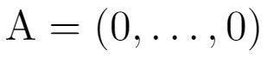
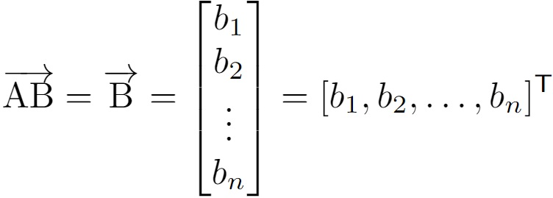
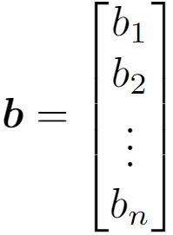
Vectors in Euclidian Spaces
Typically, the beginning point of vector is chosen to be . Hence:
Transpose operation, allows to
write row vector as column vector
row vector
representation
column vector
representation
Typical notation for vectors uses bold lowercase letters:
Examples:
B = (3, 1, 2)
B = (0.5, 1.5)
B
2
2
B
1
-1
1
2
3
1
0
1
2
-1
0
1
2

Slide 9
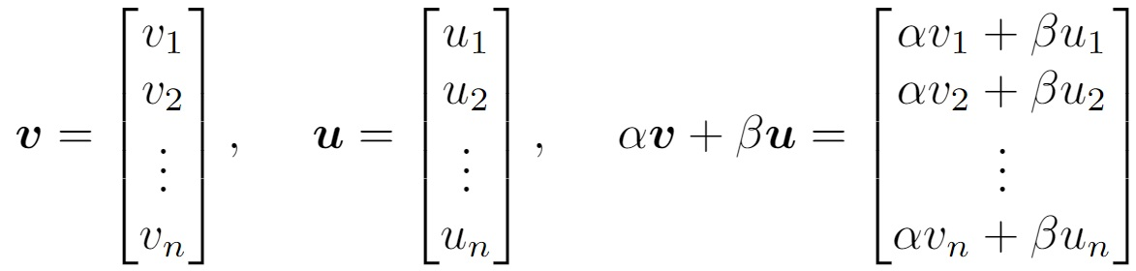
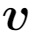
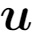
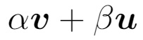
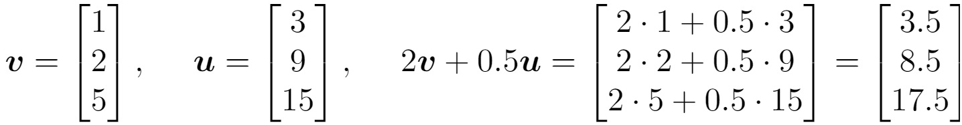
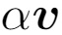
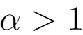
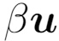
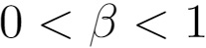
Important Operations on Vectors
Linear Operations:
both and must be
the same dimensionality
scalars
(any real numbers)
Geometric interpretation:
Examples:

Slide 10
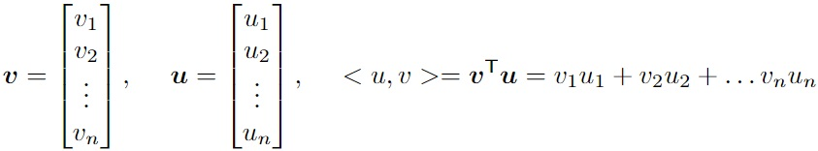
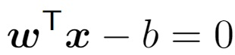
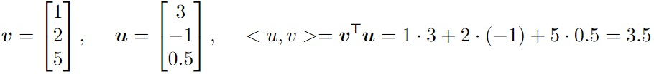
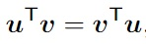
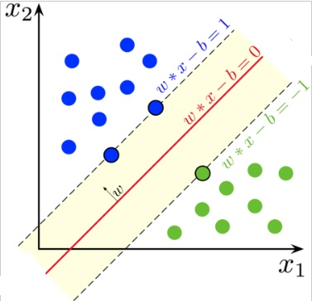



Important Operations on Vectors
Inner product:
both and must be
the same dimensionality
Result of this product
is NOT a vector, but a scalar.
Application in ML:
Examples:
Basic properties:
Maximal margin hyperplane for support vector machines has form:
Symmetry:
Multiplication on 0 vector:
parameters
Multiplication on itself:
Euclidian length of the vector
Orthogonality of vectors and :
Linearity:
scalars

Slide 11



Important Operations on Vectors
Component wise-product:
both and must be
the same dimensionality
Result of this product
is a vector.
Application in ML:
Examples:
ADAM update equations:
Component-wise product and division.

Slide 12






Important Operations on Vectors
Kronecker-product:
Vectors and can have different dimensionality
Not symmetric:
Example:
Result of this product
is a vector in

Slide 13







Vector Norms
Norm of vector is any univariate function , satisfying norm axioms:
definiteness:
absolute homogeneity :
for any vectors and scalar
subadditivity or triangular inequality:
for any vectors and
Non-negativity:
for any vector
Application in ML:
Train ML model:
Regularisation term

Slide 14







Some Vector Norms and some Not Vector Norms
Euclidian (or -norm):
-norm:
Infinity norm (or -norm):
Sparsity norm (or -norm):
One of them, actually is not a norm… Which one and why?

Slide 15








Vector Norms (Equivalence)
For the same vector different norms gives different values….
However, for any two norm s and there are constants such that:
for any vector
Equivalence of norms
Exercise:
Prove the following statements:
If is a valid norm, then is a valid distance
function between points and
For any vectors and any scalar product function:

Slide 16





Linear Independence
Collection of vectors is called linear independent if:
implies
Example:
are linearly independent
any vector in can be written as their linear
combination:
Standard Basis in
are NOT linearly independent

Slide 17

Now, we are moving to the next topic….
matrices…
Department of Economics,
Western Social Science

Slide 18




Matrices
Matrix of size m by n of real numbers has the following form:
Examples:
Typical notation for matrices are capital bold letters:
Notation implies that matrix has m rows and n columns
If m = n matric is called square matrix

Slide 19









Matrix Operations (Transpose)
Transpose operation on matrix swaps rows with columns:
Examples:
Matrix is called symmetric if:
symmetric:
NOT symmetric:
Square matrix remains square after transposition

Slide 20





Matrix Operations (Linear Operations)
Linear operation for matrices are element-wise:
for any
both must be
the same dimensionality
Examples:

Slide 21









Matrix Operations (Multiplication)
For two matrices and :
Number of columns in must be equal to number of rows in
and
where
inner product

Slide 22







Matrix Operations (Multiplication)
Examples:
Notice, number of columns in is 2
and number of rows in is 2
Matrix vector
multiplication
Exercise:
Give example of two square matrices such that
identity
matrix
Show that for any square matrix:
where

Slide 23




























Matrix Operations (Multiplication)
ML application:
. . .
. . .
Layers in neural NN are
connected via weights:
. . .
. . .
layer L
layer L+1
Results mathematical expressions:
Exercise:

Slide 24















Matrix Multiplication (Compexity)
How computational expensive is matrix multiplication?
Each entry requires
n multiplications and
n additions
There are total entries in matrix
Total number of arithmetic operations:
Best Current Theoretical Algorithm:
Widely Used Practical Algorithm
Cool Recent Advances
previous best:
But… it is galactic algorithm

Slide 25

















Inner Products of Matrices
Given two matrices and can we compute inner product between them?
Method 1: Via the Trace
Trace of the square matrix :
Example:
The inner product now can be defined as:
Example:
Exercise:
Hint:
Use definition of trace and try reordering of terms
Show symmetric property:

Slide 26






Inner Products of Matrices
Given two matrices and can we compute inner product between them?
Method 2: Via Matrix Vectorization:
Example:
Any matrix can be represented using vector notation:
OR
concatenating rows :
concatenating columns :
Now, we can use any inner product between vectors:

Slide 27








Matrix Inverse
Square matrix is called inverse to another square matrix if:
Only square matrices might have inverse.
Not all square matrices have inverse:
- is not invertible:
Identity matrix:
Example:
Matrix Inverse Computation:
But, if matrix has special structure:
Symmetric diagonal dominant
Sparse lower/upper triangular
can be inverted in a much faster way
Gaussian Elimination Algorithm
In general, big matrices
are expensive to invert…
LU Decomposition Algorihms
…

Slide 28











Solving Linear Equations
System of m linear equations with n variables have general form:
Unknown
variables :
Known variables :
In a matrix vector form can be written compactly:
Example:

Slide 29












Solving Linear Equations
Given a system of linear equations:
Can be reduced to matrix inversion problem
( by multiplying both sides on ):
square matrix:
Inverse of
Sometimes, instead of multiplying on , we also multiply on matrix such that
has desirable (for inversion) structure:
is called preconditioner
Since this reduction, linear equation solver has complexity bounded by inversion complexity:
In practice, features like sparsity of matrix of the system along with proper preprocessing can have huge
effect on performance.

Slide 30




















Solving Linear Equations (ML Application)
In linear regression task, we are given a data-set
and our goal is to find ML model that fits this data.
To find the optimal model parameter we aim optimization problem:
How can we write it in matrix vector form?
Why?
Optimal parameter
is the solution of
the following system
in this
notation
system of linear equations

Slide 31

Lets have 10 min break

Slide 32



















Eigenvalues/Eigenvectors
For square matrix a non-zero vector such that:
for some scalar
is called eigenvector of matrix corresponding to eigenvalue .
For same value you might have several eigenvectors.
Example:
- is eigenvector
with eigenvalue
Geometric meaning:
Linear mapping
transforms any vector
into a vector
such that
For any linear mapping there exist matrix such that
implies that vector does not change after transformation defined by

Slide 33
















Eigendecomposition and Diagonalisation
Square matrix is called diagonal if it has zero entries on all off-diagonal positions:
Examples:
these positions are
called diagonal
OR
OR
these positions are
called off-diagonal
A matrix is called diagonalizable if there exist an invertible matrix such that:
for some diagonal matrix
Theorem (Eigendecomposition of symmetric matrices):
Let be a collection of eigenvectors of symmetric matrix corresponding to eigenvalues ,
i.e. for . Then, matrix can be factorized as:

Slide 34






















Spectral Decomposition of Symmetric Matrix
Let us prove that any symmetric matrix can be decomposed as:
where are eigenvectors of corresponding to eigenvalues
How to show that two equal size matrices ?
We can show that their entries are equal: for
Using Eigendecomposition Theorem:
We’ll show:
for arbitrary
lets
remember:
Step II: Computing
Step I: Computing
Notice:
j
Compare:
Hence:
i
Hence:

Slide 35















Positive Semidefinite (PSD) Matrices
A symmetric matrix is called positive semidefinite (positive definite) if for any non-zero vector :
( )
( )
Notation:
Exercise:
Matrix is positive semidefinite (positive definite) if all its eigenvalues are non-negative
(positive).
ML application:
In Gaussian Processes, the symmetric covariance function defines similarity between function values and
To be proper covariance function, for any collection of points their covariance matrix must be PSD:
Examples of such functions include:
Square Exponential:
Rational Quadratic:
parameters

Slide 36






Cholesky Factorisation
Theorem (Cholesky Factorisation):
Any symmetric, positive definite matrix can be factorized into a product:
where is lower-triangular matrix (called Cholesky factor):
André-Louis Cholesky (1875 - 1918)
Example:
Computational complexity:

Slide 37








Matrix Norms
Similar to vectors, we can introduce the norm function for matrices:
Norm of a matrix is any univariate function , satisfying norm axioms:
definiteness:
absolute homogeneity :
for any matrix and scalar
subadditivity or triangular inequality:
for any matrices
Non-negativity:
for any matrix
Sub-multiplicativety:
for any matrices
ML application:
Non-linear support vector machines is trained using Log-Euclidian kernel:
Frobenius norm
to compare covariance operators

Slide 38









Matrix Norms (Examples)
Given matrix
Examples:
Frobenius norm:
Maximum norm:
Infinity norm:
Spectral norm:
Maximum
eigenvalue of

Slide 39



Vector Calculus
Derivatives, Differentiation Rules.
Partial Derivatives, Gradient, Hessian, Taylor Series.
Jacobian of a smooth mapping.
Karl Theodor Wilhelm Weierstrass
(1815 - 1897)
Gradients with respect to matrices.
Courtesy of Brad Moffat
Backpropagation.
Courtesy of IntelliPaat

Slide 40


















Derivatives, Differentiation Rules.
Let be a univariate function. The derivative of function at point is the following finite limit( if it exists):
If function has continuous derivative – it is called smooth.
Geometric interpretation:
Ratio
As
this ratio is equal to the
slope of the tangent line
at point
2
2
1
1
-1
0
1
2
-1
0
1
2
2
Not all functions are differentiable:
at
1
-2
-1
0
1
2

Slide 41


Derivatives, Differentiation Rules
To compute derivative of a function we start with known derivate expressions and the apply differentiation rules:
Known Derivative Expressions:
Example:

Slide 42









Derivatives, Differentiation Rules
To compute derivative of a function we start with known derivate expressions and the apply differentiation rules:
Differentiation rules:
Examples:
If functions are differentiable at point , then:
Product rule:
Using: and
Quotient rule:
Sum rule:
for any scalars:
Chain rule:
Using: and

Slide 43













Partial Derivatives
Let be a multivariate function. The partial derivative of function at point
are the following finite limits ( if they exist):
Example:
For compute
partial derivatives at point
…
Geometric interpretation:
Partial derivatives define slopes of the tangent line to the
curve defined by the intersection of surface of the function
and the hyperplane

Slide 44












Gradient
Gradient of function at point is a vector of all partial derivatives:
Example:
For compute the gradient at point
Geometric interpretation:
Consider paraboloid , then gradient vectors and
drawn in the plane have their initial point placed at and
respectively.
Note that the gradient vectors are calculated in component form but are translated to
their respective input points on the plane to better show the direction associated
with those points.
If we fold the plane so that , then each corresponding
gradient vector can also be mapped onto the paraboloid.
The gradient vectors mapped to and show the direction of fastest
increase.

Slide 45
















Gradient (ML Application)
In linear regression task, we are given a data-set .
Our goal is to find ML model that fits this data.
To find the optimal model parameter we aim optimization problem:
At optimal point gradient vanishes:
Let us compute this gradient:
using sum rule
using chain rule
Denote:
fix arbitrary
Index j
re-group terms
Symmetricity
of inner product
using sum rule
Why?

Slide 46















Hessian
Let be a multivariate function. Each partial derivative is itself multivariate function:
Hence, if it is differentiable, we can study partial derivatives of itself:
combining into
one matrix:
Hessan - matrix of second derivatives
Example:
For compute Hessian matrix at point
Hence:
Third column:
Second column:
First column:

Slide 47








Hessian (Geometric Interpretation). Taylor Series
Let be a multivariate function, at consider the reference point
Locally around point tangent plane gives linear approximation of the function:
Locally around point tangent second order surface gives quadratic approximation
of the function:
TAYLOR SERIES:
Similarly, adding higher order derivatives we can approximate ”good” functions at any point:
High-order
Differentiation
operator
How it works:
linear approximation
quadratic approximation
High order approximation
second - order
approximation
third - order
approximation
first - order
approximation
zero - order
approximation

Slide 48
Lets have 10 min break

Slide 49















Gradient Extensions (I)
Let be a multivariate vector function:
each component of is a multivariate function itself:
Jacobian
We can define the notion of gradient for :
Example:

Slide 50
















Gradient Extensions (II)
Let be a function of a matrix :
The gradient of
with respect to matrix :
Example:
Hence:
Consider function carefully:
Exercise:
Show:

Slide 51


















ML Application (Backpropagation I )
For training deep neural network models, the backpropagation algorithm is an efficient way to compute the gradient
of an error function with respect to the parameters of the model.
Consider feedforward computation of NN:
repeat
Layer 1
Step 1: Provide input vector to the first layer of NN
Input
vector
Step 2: Input multiplied by layer weights :
Layer 2
Step 3: Add bias parameters :
Step 4: Pass through activation function :
. . .
Step 5: Use output as input for the next layer of NN
. . .
. . .
. . .
. . .
The computation of -layer NN with weights
and biases allows iterative form:
Group unknown parameter associated with each layer of NN:
or more compactly:

Slide 52











ML Application (Backpropagation II )
Training NN constitutes in finding parameters which best fits observed data .
The fitness measure is defined via loss function:
To obtain the gradients with respect to the parameter , we compute the partial derivatives of with respect to the
parameters of each layer . The chain rule allows us to determine the partial derivatives as:
The orange terms are partial derivatives of the output of a layer with respect to its inputs.
The blue terms are partial derivatives of the output of a layer with respect to its parameters.
If we calculated then most of its computation can be reused for partial derivative
Indeed green boxes shows the additional terms we need to compute.
These additional factors can be easily computed from our iterative expressions:
Exercise:
Using derivatives of vector function,
calculate: and

Slide 53



Probability Theory
Probability and Random Variables.
Discrete and Continuous Probabilities.
Andrey Nikolaevich Kolmogorov
(1903-1987)
Sum Rule, Sum Product, Bayes Theorem.
Summary Statistics, Independence.
Gaussian Distribution.
Source: Google Images

Slide 54





















Probability Space
The probability space models a real-world process (referred to as an experiment)with random outcomes. It consists of three components
THE SAMPLE SPACE
Example:
The sample space is the set of all possible elementary
outcomes of the experiment.
Coin toss:
Roll a dice:
THE EVENT SPACE
The event space is the space of potential results of the experiment.
Each event consists of elementary outcomes, i.e.
The set of all events is a power set of , and denotes:
Event of getting TAIL in a coin-flip:
Event of getting even number in a roll dice:
THE PROBABILITY
With each event , we associate a number
that measures the probability or degree of belief that the event will
occur. is called the probability of
Probability of getting TAIL in a coin-flip:
Probability of getting even number in a roll dice:
Remark:
chance of … = the probability of …
The chance of … is 33% = The probability of … is 0.33

Slide 55






































Random Variable
In machine learning, we often don’t refer to the probability space, but
instead refer to probabilities on quantities of interest denoted by
Example:
Random variable defined on a set of roll dices:
A random variable is a mapping that takes an element
and returns a an element
In this case:
-10
For any subset we associate (the probability)
to a particular event occurring corresponding to random variable
1
0
3
2
preimage of S
Random variable defines probability distribution on the target space .

Slide 56











































Discrete Probabilities
Consider the case when we can enumerate all elements in the target set .
In other words,
Examples:
Random variable defines a probability distribution on , such that
for any its probability .
Hence, discrete random variable is characterized by a probability
mass function , such that and
Consider and :
Consider and :
with
JOINT PROBABILITY FOR RANDOM VARIABLES:
Discrete random variables: and , and .
Joint Probability of is defined as:
and
,
x
and
y
Hence:

Slide 57




Discrete Probabilities
Consider the case when we can enumerate all elements in the target set .
In other words,
Examples:
Random variable defines a probability distribution on , such that
for any its probability .
Hence, discrete random variable is characterized by a probability
mass function , such that and
Consider and :
Consider and :
with
CONDITIONAL PROBABILITY FOR RANDOM VARIABLES:
Discrete random variables: and , and .
Conditional Probability of is defined as:
and
,
Notice, in contrast with joint probability, here we are looking for
elementary outcomes giving
and
only in the preimage ,
rather than the whole set .
Hence:

Slide 58






















Continuous Probabilities
Consider now when the target set is not countable, for example .
We interested in the probability that a random variable is in the
interval, i.e. for .
To compute it, we introduce cumulative distribution function (cdf):
A function is called probability density function (pdf) if:
Non-negative: for any
Integrable:
Example:
Probability density function:
Cumulative distribution function:
with probability = to its length:
1
1
For any interval we have:
0
1
0
1

Slide 59
























Sum Rule
DISCRETE RANDOM VARIABLES:
CONTINUOUS RANDOM VARIABLES:
Unify notation for discrete
and continuous random variables
Probability
density
functions
Probability
mass functions
SUM RULE:
sum out (or integrate out)
the set of states of the
random variable
This operation is called
marginalisation
Consider random variables:
and
ML application:
marginal
distribution
Interpretation:
latent/hidden
variables
In latent variable models we marginalise observations over the latent variables :
observed
variables

Slide 60






Product Rule
DISCRETE RANDOM VARIABLES:
CONTINUOUS RANDOM VARIABLES:
Unify notation for discrete
and continuous random variables
Probability
density
functions
Probability
mass functions
PRODUCT RULE:
Every joint distribution of two random variables can be factorized of two other distributions.
The two factors are the marginal distribution of the first random variable , and the conditional distribution of the second random variable given the first
Consider random variables:
and
ML application:
In Reinforcement Learning the probability of state action trajectory:
is factorised using of product rule:
Environment
Agent

Slide 61













Bayes Theorem
In machine learning and Bayesian statistics, we are often interested
in making inferences of unobserved random variable , given that
we have observed other random variable , related to
- our initial guess about hidden variable
- relationship between and observed
Can we draw any conclusions about given our observations ?
Using product rule:
Similarly:
YES – using Bayes Formula
Thomas Bayes
(1701-1761)
- prior distribution over hidden variable
- likelihood, describing conditional probability of given .
- posterior distribution, which is the quantity of interest, as it reflects conditional probability of given .
- marginal likelihood/evidence “weighted average” of likelihood , with weighs defined by prior
using sum rule
and then product rule

Slide 62















Summary Statistics (Expected Value)
Weighted average expression over distribution is a special case of statistics. A statistic of a random variable is a deterministic function of that random variable. They provide a general view on the behavior of a random variable.
Two most popular statistics of random variable are mean and variance .
MEAN (MATHEMATICAL EXPECTATION, EXPECTED VALUE, FIRST MOMENT)
Example:
CASE I (Discrete):
Let be a discrete random variable with the target set
and the probability mass function
for . The expected value of is a sum:
Consider a fair dice (all sides are equally probable = ) and random variable :
CASE II (Continuous):
Let be a continuous random variable with the target
Set and the probability density function . The mean
value of is given by an integral (if it exist):
Consider with pdf :
1
0
1

Slide 63




Summary Statistics (Variance)
Weighted average expression over distribution is a special case of statistics. A statistic of a random variable is a deterministic function of that random variable. They provide a general view on the behavior of a random variable.
Two most popular statistics of random variable are mean and variance .
VARIANCE (DISPERSION, SECOND MOMENT)
Example:
CASE I (Discrete):
Let be a discrete random variable with the target set
and the probability mass function
for . The variance of is a sum:
Consider a fair dice (all sides are equally probable = ) and random variable :
We know:
CASE II (Continuous):
Let be a continuous random variable with the target
Set and the probability density function . Then, the
variance of is given by an integral (if it exist):
Consider :
We know:

Slide 64








Summary Statistics (ML Application)
Weighted average expression over distribution is a special case of statistics. A statistic of a random variable is a deterministic function of that random variable. They provide a general view on the behavior of a random variable.
Mean and Variance are used almost everywhere in ML:
VARIOUS ML APPLICATIONS OF MEAN/VARIANCE:
In Supervised Learning:
Here:
Training loss function for ML models is usually represented as empirical mean:
training
data-set
ML model
(Neural Network)
In Bayesian Optimisation:
Here:
UCB acquisition function for Bayesian Optimisation has the following form:
is posterior mean of GP model
is posterior variance of GP model
is collection of black-box observations.

Slide 65















Independence
Two random variables are statistically independent if and only if:
Examples:
Flipping a coin several times, then random variables
associated with each such trial are independent.
Intuitively, are independent if the value of one of them does not add
any additional information about the value of another.
Roll a dice (random variable ) and then sample
a point . Then, are independent
Roll a dice (random variable ) and then sample
a point . Consider random variable
ML application:
In machine learning, we often consider problems that can be modeled as
independent and identically distributed(i.i.d.) random variables. For example,
in supervised learning, training data-set is assumed to consist of i.i.d. samples.
In Reinforcement learning, for a fixed policy the sampled trajectories are i.i.d.
Then, are not independent.
SOME PROPERTIES OF RANDOM VARIABLES:
If are independent, then: and
If are independent, then:
If are independent, then: and
If are independent, then: where are integrable.
If are random variables (might be dependent), then: where
Linearity of Expectation

Slide 66




















Gaussian Random Variable
The Gaussian (normal) distribution is the most well-studied probability distribution for
continuous-valued random variables. It has application in many fields of ML, including
diffusion models, normalizing flows, Kalman filters, Gaussian processes ,etc.
The Gaussian random variable can be (i.e. ) or
(i.e. ) and can be fully determined by its first and second moments:
Carl Friedrich Gauss
(1777-1855)
1-DIMENSIONAL CASE:
-DIMENSIONAL CASE:
Probability density
function:
- is expected value of
- is expected value of
covariance matrix:
- is variance of
- is variance of
Examples*:
projection:
*Source: “Mathematics
for Machine Learning”.
https://mml-book.com.

Slide 67
















Properties or Gaussian
The Gaussian (normal) distribution is the most well-studied probability distribution for
continuous-valued random variables. It has application in many fields of ML, including
diffusion models, normalizing flows, Kalman filters, Gaussian processes ,etc.
1-DIMENSIONAL CASE:
-DIMENSIONAL CASE:
Carl Friedrich Gauss
(1777-1855)
Sum of independent
Gaussians:
Let and be two independent Gaussian random variables. Then, for any :
-dimensional version for and :
Linear transformation
of Gaussian:
Let be a multivariate Gaussian, and be an arbitrary matrix. Consider random variable
- which is linear transformation of by . Then:
Mixture of univariate
normal densities:
Let and be two Gaussian densities and . Consider density:

Slide 68


Loss Functions in ML
Regression Loss Function
Classification Loss Function
Source: https://www.cs.cornell.edu

Slide 69




















Regression Loss Function (MLE)
REGRESSION TASK SETUP:
- unknown function we want to model.
- our ML model (typically NN) to approximate .
- observed data-set, where input variables, and are noisy observations.
Find parameter such that
GOAL:
We assume that
Hence, probability density of points sampled independently defines the likelihood function:
i.i.d.
samples
In other words, maximising log-likelihood we arrive at mean squared error (MSE) loss function.
If we replace we get mean absolute error (MAE) loss:

Slide 70











Regression Loss Function (MAP)
REGRESSION TASK SETUP:
- unknown function we want to model.
- our ML model (typically NN) to approximate .
- observed data-set, where input variables, and are noisy observations.
Previously, we found parameter value maximising the probability of observing data points
Now, lets treat as random variable itself and for a given data aim to find most probable value of model parameter :
Let assume prior distribution . Then we need to maximise posterior distribution:
Using Bayes Formula: gives:
Step 3: Using prior
distribution expresion
Step 1: Evidence does not
depend on model
Step 1:
Step 2:Taking log
Step 2:
In other words, maximising a posteriory probability we arrive at L-2 regularized mean squared error (MSE) loss function.
If we replace prior from Gaussian to Laplace, i.e then we arrive to L-1 regularised mean squared loss function:
Step 3:

Slide 71

















Classification Loss Function
CLASSIFICATION TASK SETUP:
- observed data-set, where input variables, and each .
- our ML model classifier (typically NN), outputting two dimensional stochastic vector.
where defines probability that
Find parameter such that classifier maximizes the proper labelling of input points.
GOAL:
It means, should be close to one when input point belong to the first class ( ), and it should be close to zero when input point belongs to the second class ( ).
To combine these requirements, consider the following likelihood expression:
Notice, each output , it returns
the expression we need to maximization:
Aiming maximisation of the likelihood:
Step 1: i.i.d. distribution
Step 2: Using expression for
the likelihood
Step 1
Step 2
Step 3: Transition to log
Step 3
We arrive at cross entropy loss function.

Slide 72

Thank you

